Slide 1
Mars: Science and Engineering
Howard Seltman
CMU Osher
Fall 2023

Slide 2
Course Goals
Show how robotic spacecraft work
Show what they have found out about Mars
Explore the iterative interplay between the science and the engineering
Show both triumphs and failures
Show the human side of the scientists and engineers
Discuss possible future human missions to Mars

Slide 3
About me and you
Science Background
  Ground a 6-inch mirror and built a telescope at age 13
  BA in Biology from Oberlin including field geology course
  MD from Medical College of Pennsylvania
  Clinical Pathology including microbiology and clinical chemistry
  PhD in Statistics
Engineering Background
  Devoured “The Way Things Work” at age 12
  Repaired radios and televisions as an early teen
  Ham radio operator with home-built equipment as a teen
  Designed, built and programmed a system to automate radioimmunoassays
  Extensive experience with laboratory instrumentation included gas chromatography/mass spectrometry

Slide 4
Course outline
Week 1
  Astronomy background
  Early flights with no or minimal success
  US Mariner Program (1960s)
Week 2
  1970s: USSR Mars 4-7, US Viking program
  1990s: MGS, Pathfinder lander with Sojourner rover, Nozomi
Week 3
  Early 2000s: Odyssey, Spirit & Opportunity, Mars Express
  Late 2000s: Mars Reconnaissance Orbiter, Phoenix lander
Week 4
  2010s: Curiosity, MAVEN, Mangalayan, Insight
  2020s: Perseverance, Ingenuity, Tianwen, Emirati Hope
  Future: EscaPADE, Exo-Mars
  Far future: humans on Mars

Slide 5
Some sources
NASA: https://www.nasa.gov
NASA Space Science Data Coordinated Archive: http://nssdc.gsfc.nasa.gov
JPL: https://www.jpl.nasa.gov
European Space Agency: https://www.esa.int
Planetary Society : https://www.planetary.org
Wikipedia
Marspedia: https://marspedia.org
The Search for Life on Mars by Elizabeth Howell and Nicholas Booth
The Viking Missions to Mars by John Hamilton
Managing Martians by Donna Shirley
The Right Kind of Crazy by Adam Steltzner
Roving Mars by Steven Squyres
The Design and Engineering of Curiosity by Emily Lackdawalla
Beyond Earth: A Chronicle of Deep Space Exploration by Asif A Siddiqi https://www.nasa.gov/connect/ebooks/beyond_earth_detail.html

Slide 7
Knowledge of the sky before the space age
Early humans must have recognized the movement and phases of the moon, apparent patterns in the stars (constellations), the movement of the stars through the night, the yearly star cycle, and the presence of the five naked-eye planets (Mercury, Venus, Mars, Jupiter, and Saturn) as they “wander” among the stars
Egyptian, Babylonian and Chinese star tables go back 3000 to 4000 years

Slide 8
The movement of the stars
Revolution Around the Sun (1:42) [Conceptual Academy: Observing the Night Sky]
Rotation on Our Axis (0:23) [MissGoin4U: North Star Star Trails]

Slide 9
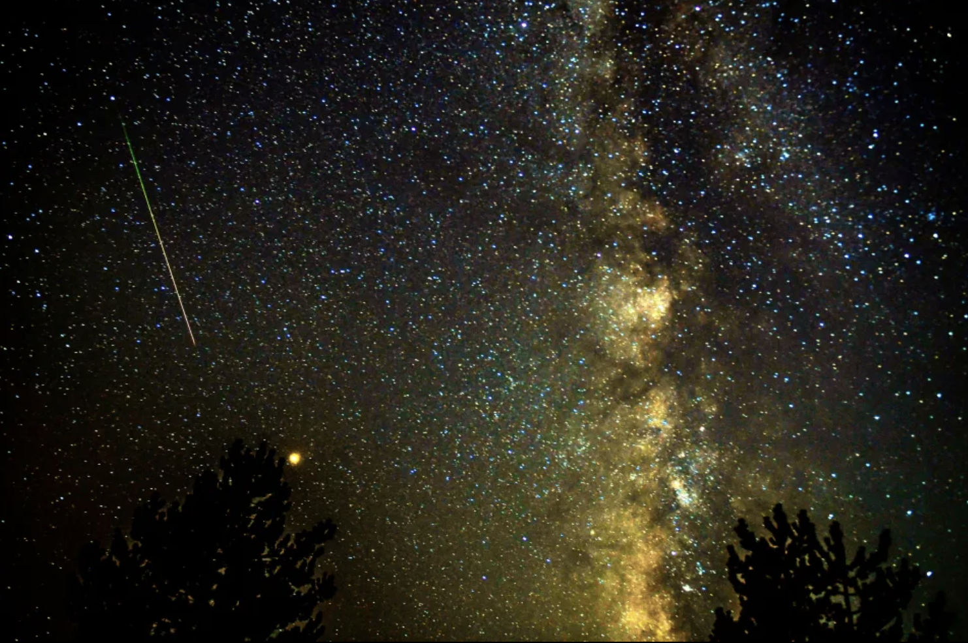
Naked eye observation of Mars
Seeing Mars (3:40) [Youtube: Learn the Sky]

Slide 10
Knowledge of Mars before the modern era
Aristarchus of Samos (c. 310 – c. 230 BCE) presented the first known heliocentric model of the solar system
The geocentric model in the Almagest of Ptolemy (circa 100 – circa 170 AD) dominated astronomy for over 1300 years
Copernicus (1473 – 1543) provided convincing evidence of the heliocentric solar system
Galileo (1564 – 1642) was the first to see Mars through a telescope
Mars was first mapped by Christian Huygens in 1659, who saw the ice caps, and measured the diameter and day length
In 1704 Jacques Philippe Maraldi observed periodic changes in the sizes of the ice caps
In the 1870s Eugène M. Antoniadi saw windblown dust storms

Slide 11
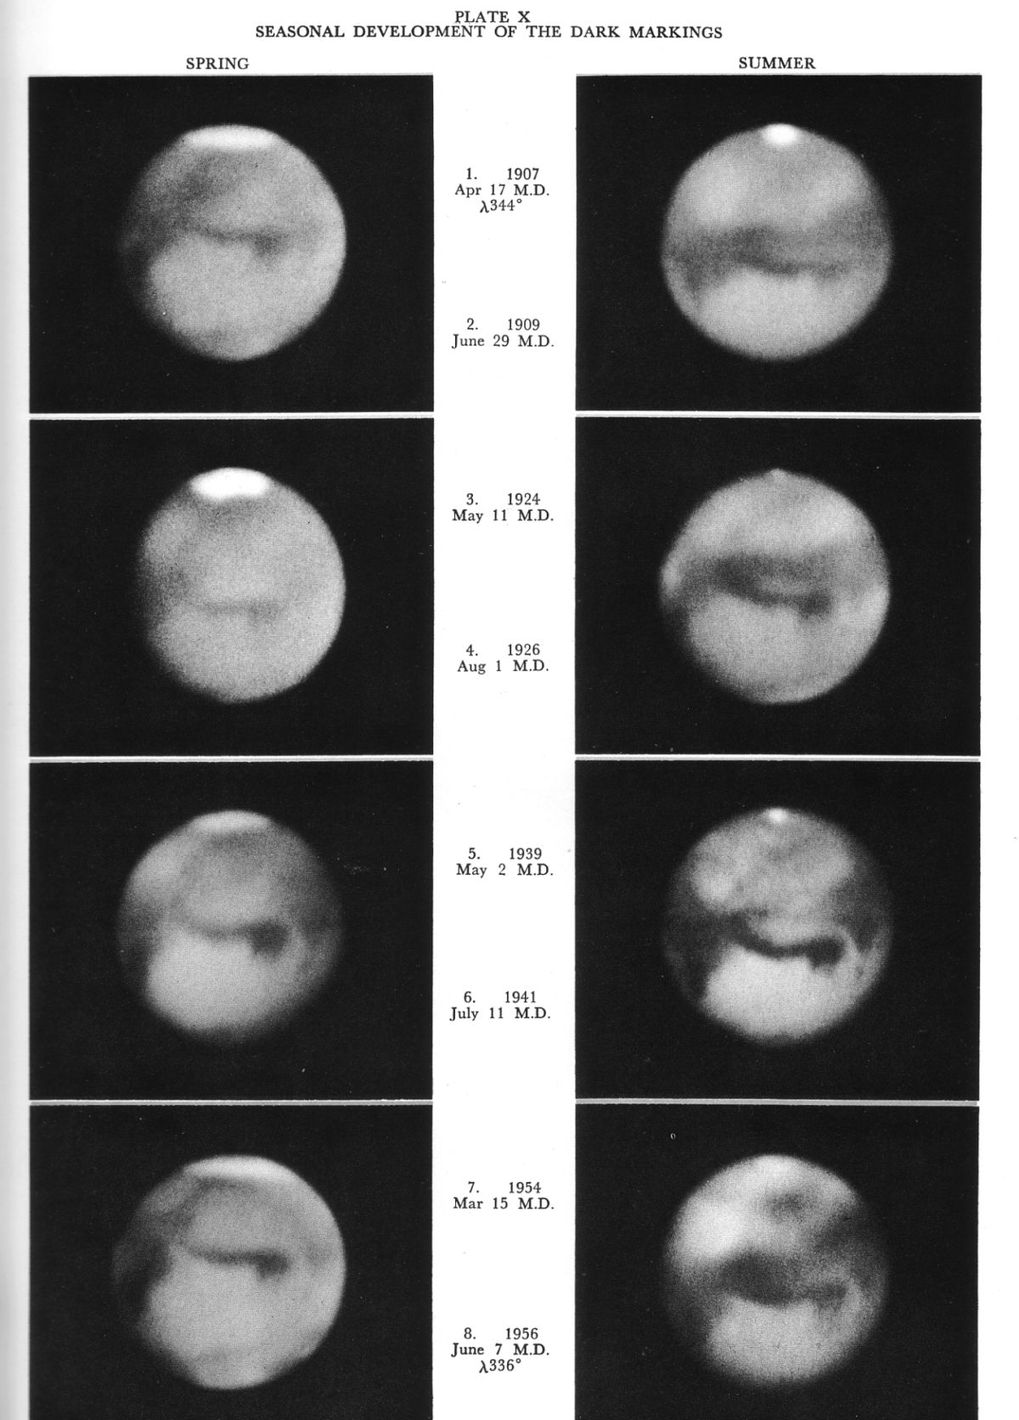
Percival Lowell
American businessman and amateur astronomer (1855-1916)
Founded Lowell Observatory outside of Flagstaff, AZ
Studied, photographed and drew Mars from 1893 to 1908
Believed he saw canals, oases, and crop cycles
Mostly rejected by the scientific community, but highly popular
Stimulated science fiction!
Work continued by Earl Slipher until 1961

Slide 12
Knowledge of Mars before the space age
In 1924 American astronomers Seth Nicholson and Edison Pettit, working at Mount Wilson Observatory used a vacuum thermocouple to estimate the temperature as −90 °F (−68 °C) at the pole and 45 °F (7 °C) at the equator. Americans William Coblentz and Carl Lampland showed that the nighttime temperature dropped to −121 °F (−85 °C)
In 1926 Walter Adams used spectroscopy to measure the amount of oxygen and water vapor in the atmosphere. He determined that "extreme desert conditions" were prevalent on Mars. In 1934, Adams and Theodore Dunham Jr. found that the amount of oxygen in the atmosphere of Mars was less than one percent of the amount on Earth.

Slide 13
More facts about Mars
Sun-Mars distance varies from 128 to 155 million miles
From https://solarsystem.nasa.gov/planets/mars/in-depth/
  “As Mars orbits the Sun, it completes one rotation every 24.6 hours. Martian days are called sols – short for ‘solar day.’ A year on Mars lasts 669.6 sols, which is the same as 687 Earth days.
  “Mars' axis of rotation is tilted 25 degrees with respect to the plane of its orbit around the Sun. […Earth’s is 23.4 degrees]. [Mars’ seasons last longer than] seasons here on Earth since Mars takes longer to orbit the Sun, [and are uneven] … because of Mars' elliptical, egg-shaped orbit around the Sun.
  “Spring in the northern hemisphere (autumn in the southern) is the longest season at 194 sols. Autumn in the northern hemisphere … is the shortest at 142 days. Northern winter … is 154 sols, and northern summer … is 178 sols.”

Slide 14
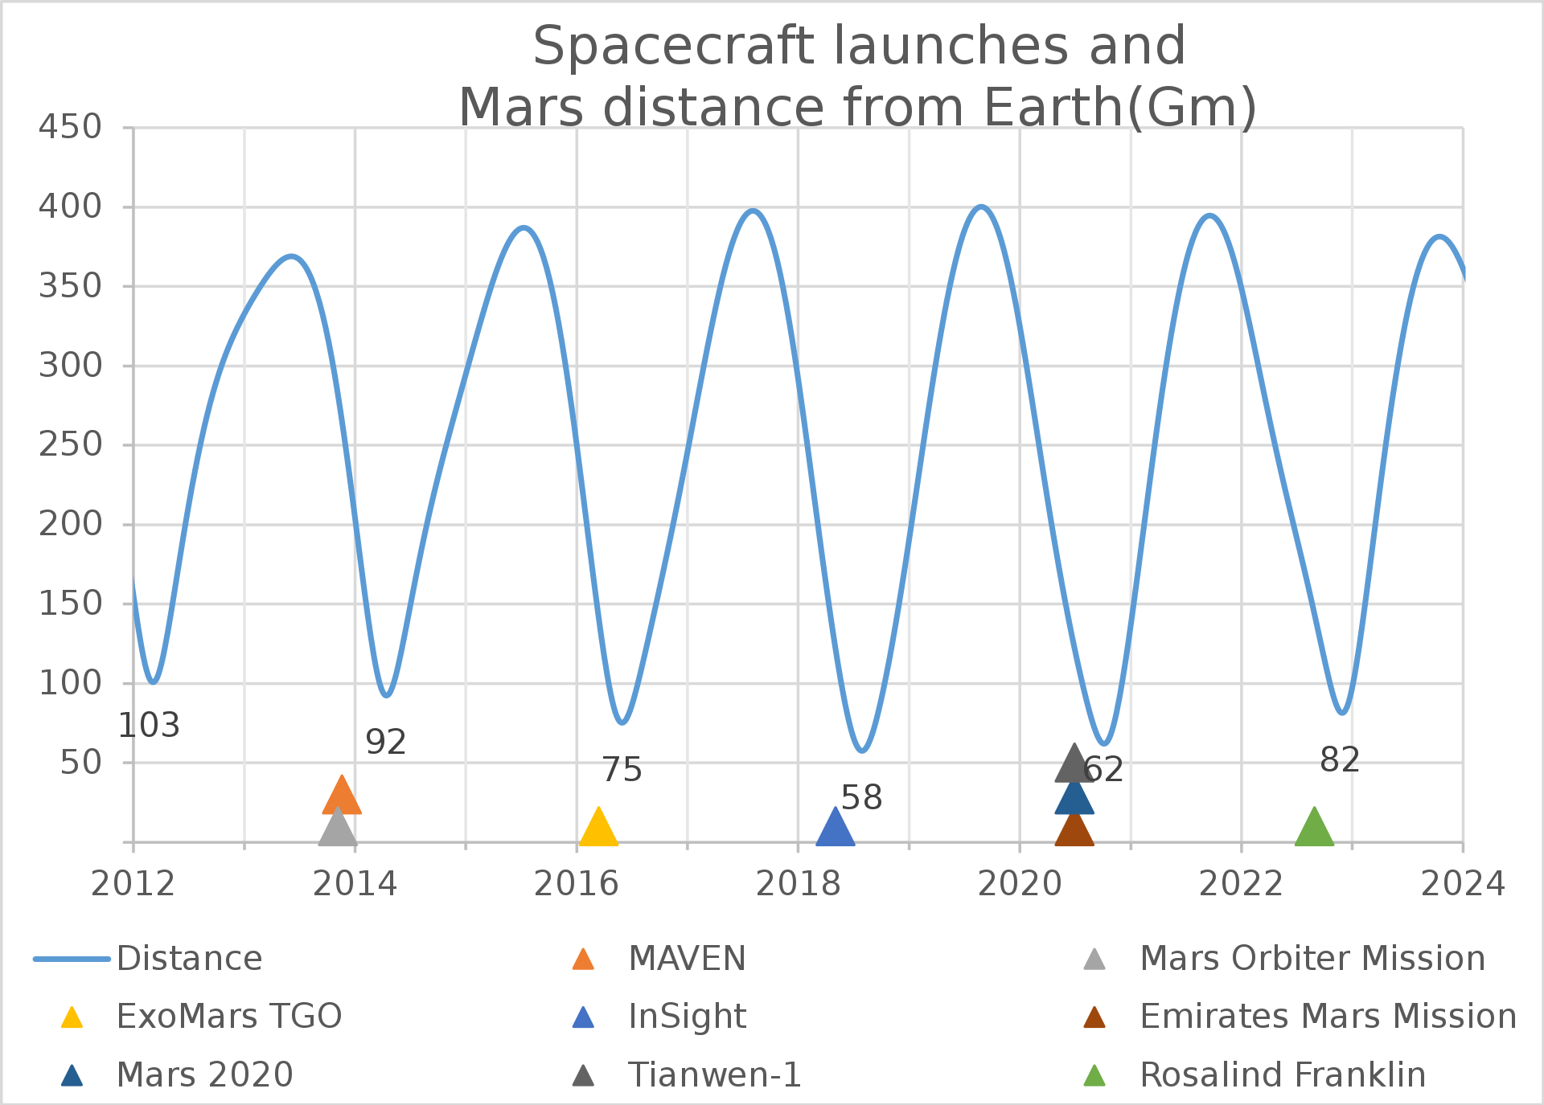
Hohmann Transfer Orbit
Hohmann Transfer Orbit (1:00)

Slide 15
Some challenges for visiting Mars
Launch periods/windows and trajectory planning
Rockets powerful and reliable enough
Rocket guidance
Cost, reliability, and capability (weight) trade-offs
Choice of scientific instruments
Entry, descent and landing
Effects of radiation, low temperature, temperature change, dust, and low gravity on equipment
Known unknowns
Unknown unknowns

Slide 16
Early USSR Missions
Soviet Mars missions, based on Venera hardware, were far from successful, with nine failures from 1960 to 1969.
November 1962: Soviet Mars 1
  Upper stage fired out of Earth orbit towards Mars
  An attitude control valve failed, expending all its N₂ gas
  Backup gyro control kept solar panels pointed to the sun
  Successfully collected interplanetary data
  Lost antenna pointing and flew by Mars at 122,000 miles in June 1963

Slide 17
US Mariners and JPL
Spacecraft built by JPL (Jet Propulsion Laboratory)
Total Mariner 1-10 cost: $554 million ($5.4 billion today)
JPL
  Started as the rocket propulsion lab of Theodore Von Kármán in the 1930s at Caltech University
  Located off-campus, in a 168-acre canyon north of the Rose Bowl
  1943: Hired by the US army to understand, duplicate, and improve on the German V-2 rockets. Took the name JPL.
  Worked with Army Ballistic Missile Agency to launch the first US satellite, Explorer 1, in 1958
  Transferred from Army to NASA in December 1958
  Got Mariner Program contract in 1960

Slide 18
Mariners 1 and 2 (to Venus)
July 1962, Mariner I was supposed to fly by Venus. It was destroyed approximately 5 minutes after liftoff by the Air Force Range Safety Officer when its malfunctioning Atlas-Agena rocket went off course.
NASA Space Science Coordinated Archive: “[T]he Mariner 1 Post Flight Review Board determined that the omission of a superscript overbar when translating the handwritten equations into the coded computer instructions allowed transmission of incorrect guidance signals (basically instantaneous values instead of smoothed values) to the spacecraft [...] This caused the rocket to swing automatically into a series of unnecessary course corrections with erroneous steering commands which finally threw the spacecraft off course.”
Mariner 2 successfully flew by Venus in August 1962

Slide 19
To Mars: Mariner 3/4 construction
Mariner 3/4 cost: $83.2 million (about $807 million today)
Launched on a General Dynamics Atlas/Agena rocket
  The Atlas was developed as an ICBM. It had booster engines fueled by RP-1 (highly refined kerosene) and liquid oxygen and which were discarded when empty, and a central RP-1/LO₂ engine, both with gimbaled engines and inertial guidance.
  The Agena used a Bell Aerosystems engine using dimethylhydrazine (DMH) as the fuel, and red fuming nitric acid (RFNA) as the oxidizer, originally developed for bomber jets. It had gimbaled nozzles for steering.

Slide 20
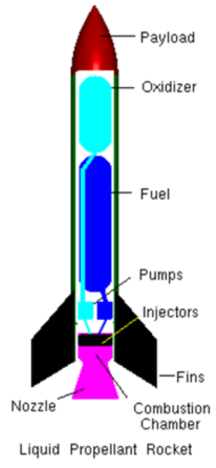
Rocket primer
Based on Newton’s third law of motion: For every action there is an equal and opposite reaction
Main types:
  Monopropellant produces gasses when in contact with a catalyst
  Fuel plus oxidizer: produce gasses when mixing propellant and oxidizer
    with an igniter (non-hypergolic)
    without an ignitor (hypergolic fuels)
Gasses are expelled through a nozzle, causing the rocket to move in the opposite direction
Steering is with movable fins, movable (gimbaled) engines, movable exhaust nozzles, or extra “vernier” thrusters

Slide 21
Inertial guidance
Three gyroscopes at right angles measure direction
Three accelerometers at right angles measure acceleration
Circuits integrate acceleration to get velocity
Integration of velocity produces position
Feedback relative to stored desired position keeps the rocket on trajectory
This is a form of “dead reckoning”

Slide 22
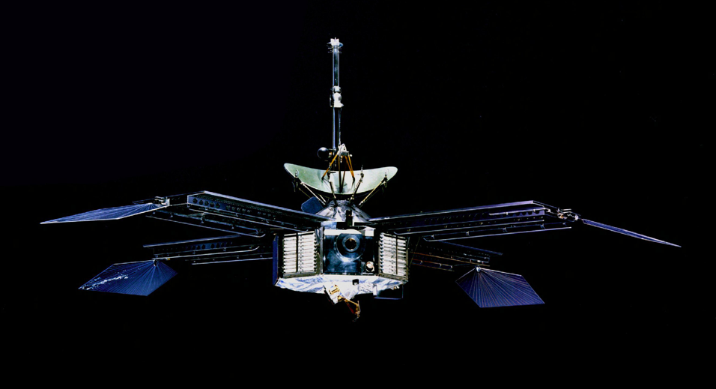
Mariner 3/4 spacecraft
575 pounds, 54,000 parts
4’4” octagonal magnesium frame 1.5 feet high
Four solar panels: 70 square feet, 7000 cells, 300 watts
Rechargeable silver zinc battery, 1200 watt-hours
Two 10-watt microwave-band transmitters
Hydrazine monopropellant course correction engine

Slide 23
Mariner 3/4 instrumentation
Star tracker (locking on Canopus)
High-gain parabolic antenna (33 bits/second) [4G=100 Mb/s]
Omnidirectional low gain antenna (8 bits/second)
Magnetometer
Geiger counter (failed)
Low energy radiation detector
Cosmic ray detector
Solar plasma detector
Cosmic dust detector
Television camera: first ever digital camera
5-megabit magnetic tape recorder

Slide 24
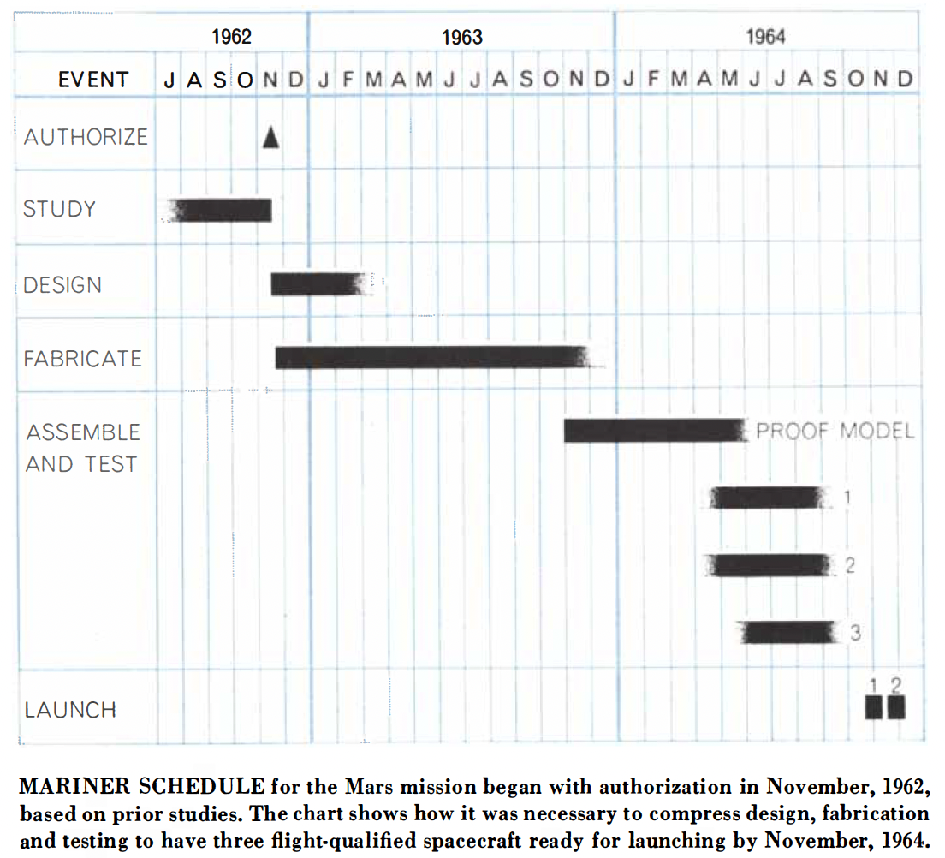
Mariner 3/4 schedule

Slide 25
Mariner 3/4 testing
Test chamber built to simulate temperature, pressure (vacuum), vibration and lighting
Tested for 3500 hours (vs. 6000-hour trip to Mars)
Problem types: too lightweight for vibrations experienced, deterioration with time, outgassing
Data automation subsystem controls all other components and sends data to the transmitters. The resistors reacted with the boron coating compound used to “radiation harden” the electronics and changed resistance. A glass coating was applied before the boron coating, in a new data automation subsystem, but there was no time for re-testing.

Slide 26
Mariner 3
Mariner 3 attempt to fly by Mars in November 1964
  In an attempt to reduce weight, a fiberglass shroud (fairing) was used for the first time
  The spacecraft was found to be traveling 670 mph too slow – traced to the extra 290 pounds of the shroud still being attached
  Battery discharge showed that the solar panels did not deploy
  Manual command to detach the shroud failed
  Plan to use a midcourse engine firing to shake the fairing loose failed because it was too late
  Eight hours after launch the batteries died, and the mission ended
  Only 27 days were left in the launch period, but a new metal shroud, only a few pounds heavier, was fabricated in 23 days

Slide 27
Mariner 4 operation summary
Launch November 28, 1964 Mariner 4 Launch Movie (1:03)
The star tracker lost Canopus multiple times, and the problem was traced to sunlight reflecting off dust coming off the vehicle
A flight correction was successfully made December 5
The fly-by was July 14/15, 1965, with a 6,118-mile closest approach, 134 million miles from Earth at 4.3 miles/second relative to Mars. Twenty-one pictures were taken covering 1% of the surface. Each took 8 hours to transmit.
Interplanetary data was recorded at 10⁻¹⁸ watts until Oct. 1965

Slide 28
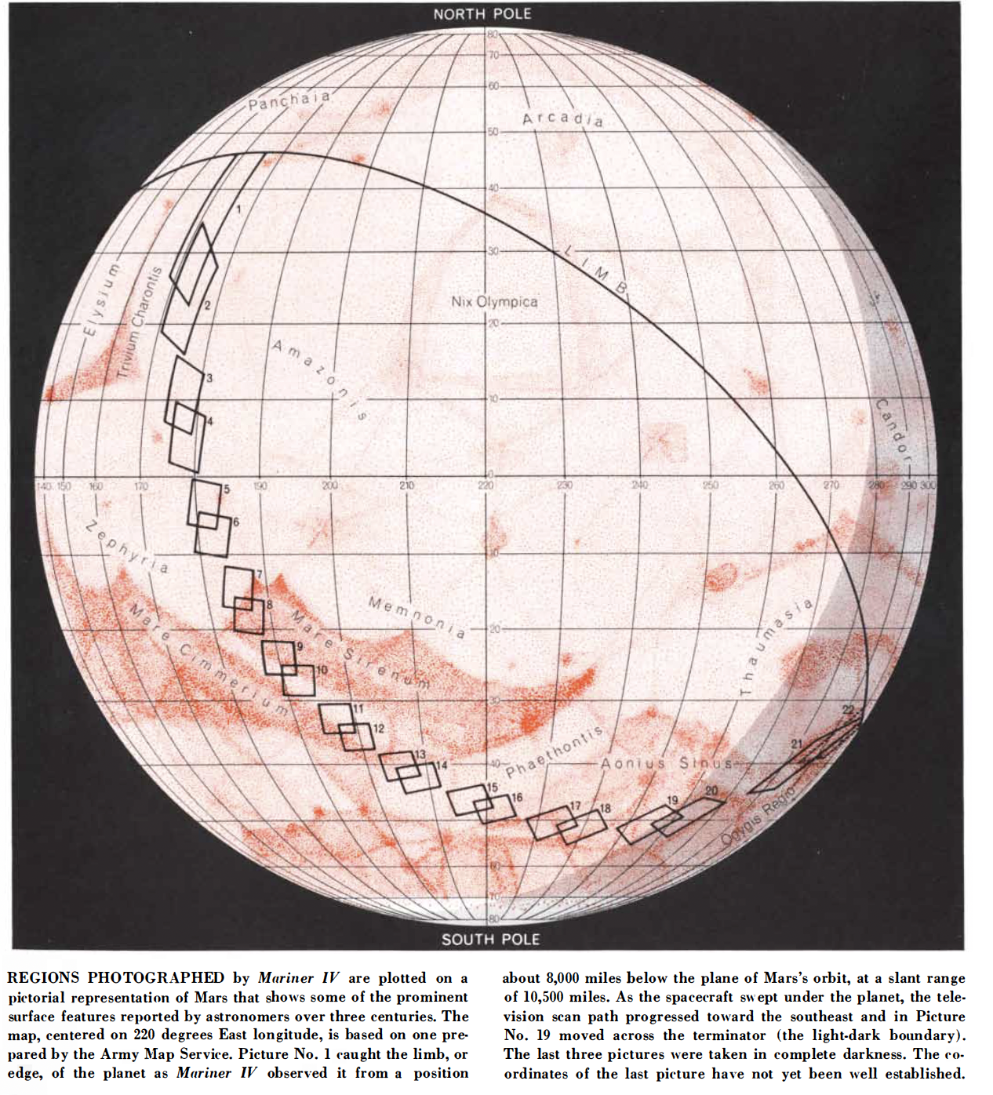
Mariner 4 regions photographed

Slide 29
Mariner 4 videos
Before reaching Mars: Mariner 4 NASA Documentary Part 1 (9:09)
At Mars: Mariner 4 NASA Documentary Part 2 (9:30)

Slide 30
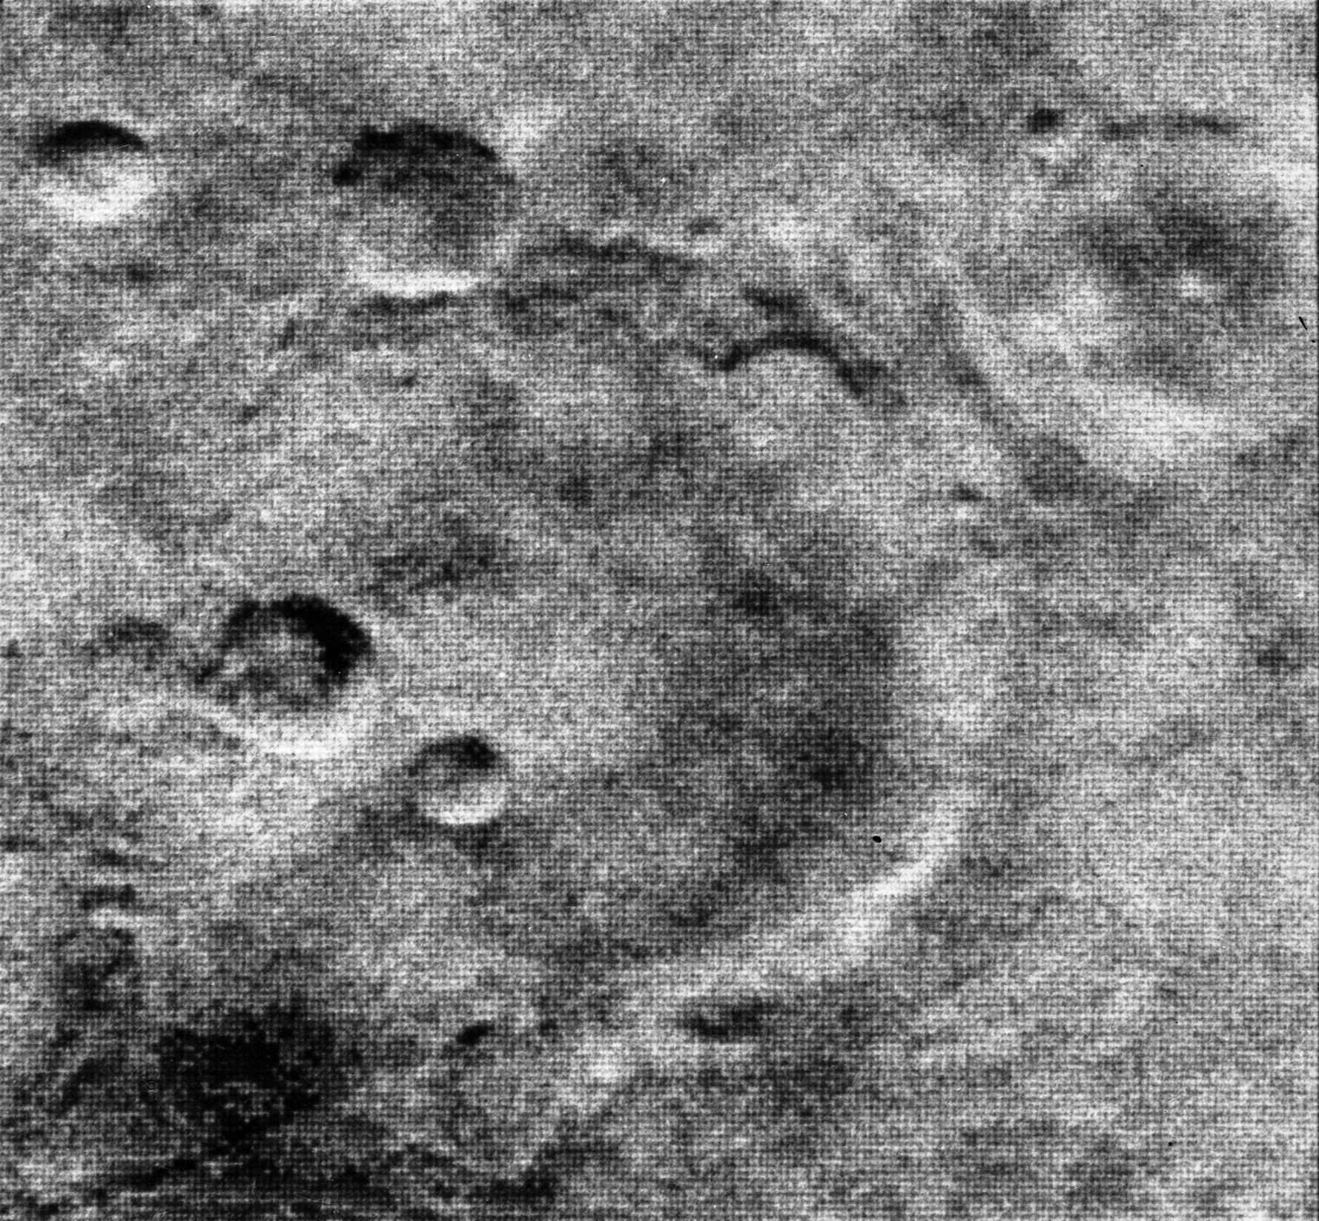
Some Mariner 4 science results
Total data 634 kB. All instruments OK except the Geiger counter
En route solar flares and micrometeors detected
No magnetic field or radiation belts were detected around Mars
Atmosphere was found to be very thin: 10 to 20 millibar
From the (non-representative) images, it was concluded that Mars was heavily cratered, and more moon-like than Earth-like
r

Slide 31
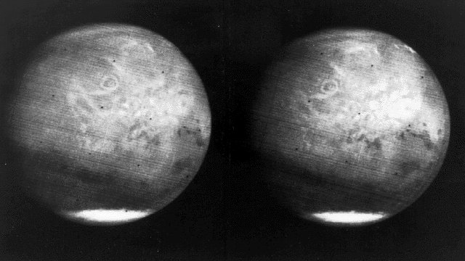
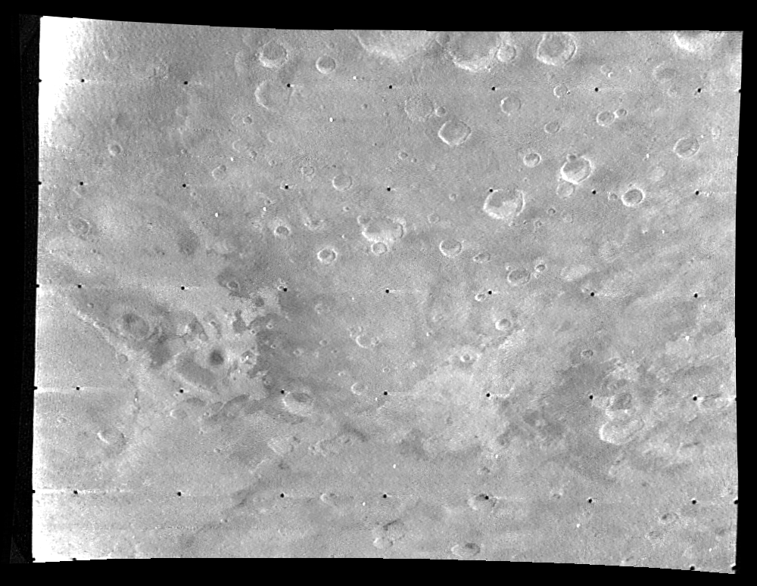
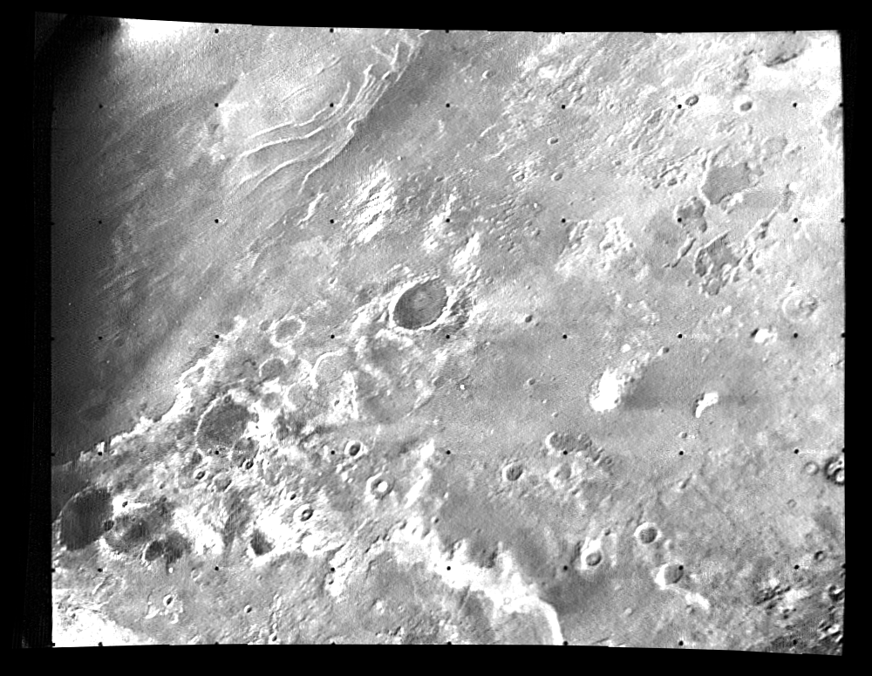
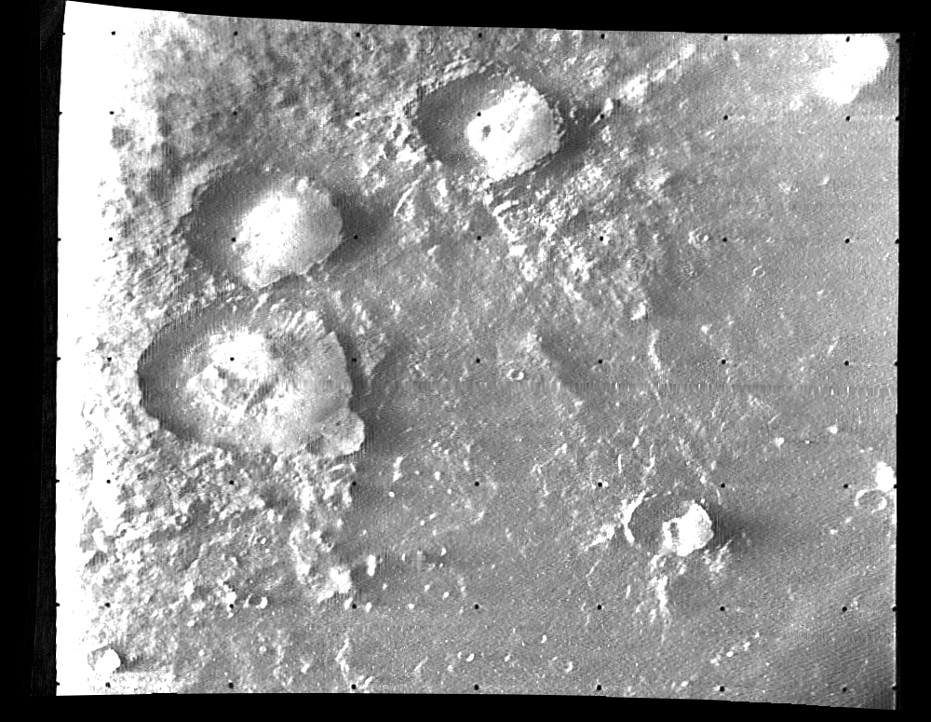
Mariner 5-7
Mariner 5: to Venus, failure of Agena burn
Mariner 6 and 7: Successful July 1969 Mars fly-bys
  201 photographs covering 20% of Mars
  Found trace amounts of surface water by spectrometer

Slide 32
US Mariners 8-9, Soviet Mars 2+3
Mariner 8: Second stage tumbled out of control (bad diode)
Mariner 9: Launch to Mars May 30, 1971
  First spacecraft to orbit another planet on November 19, 1971
Soviet Mars 2 and Mars 3 launched earlier, arrived weeks later
  Mars 2 orbited and took measurements and pictures (mostly of a huge sandstorm) and dispatched a lander that crashed
  Mars 3 orbited and successfully dispatched a lander which lasted 110 seconds and took a bland, partial picture
Mariner 9 waited till after the dust storm and took 7,329 images through October 1972, covering 85% of Mars. Resolution improved from 2,660 to 320 ft per pixel
Introduced error correcting code for data transmission
Identified extinct volcanoes, riverbeds, craters, canyons, evidence of wind and water erosion and deposition, weather fronts

Slide 33
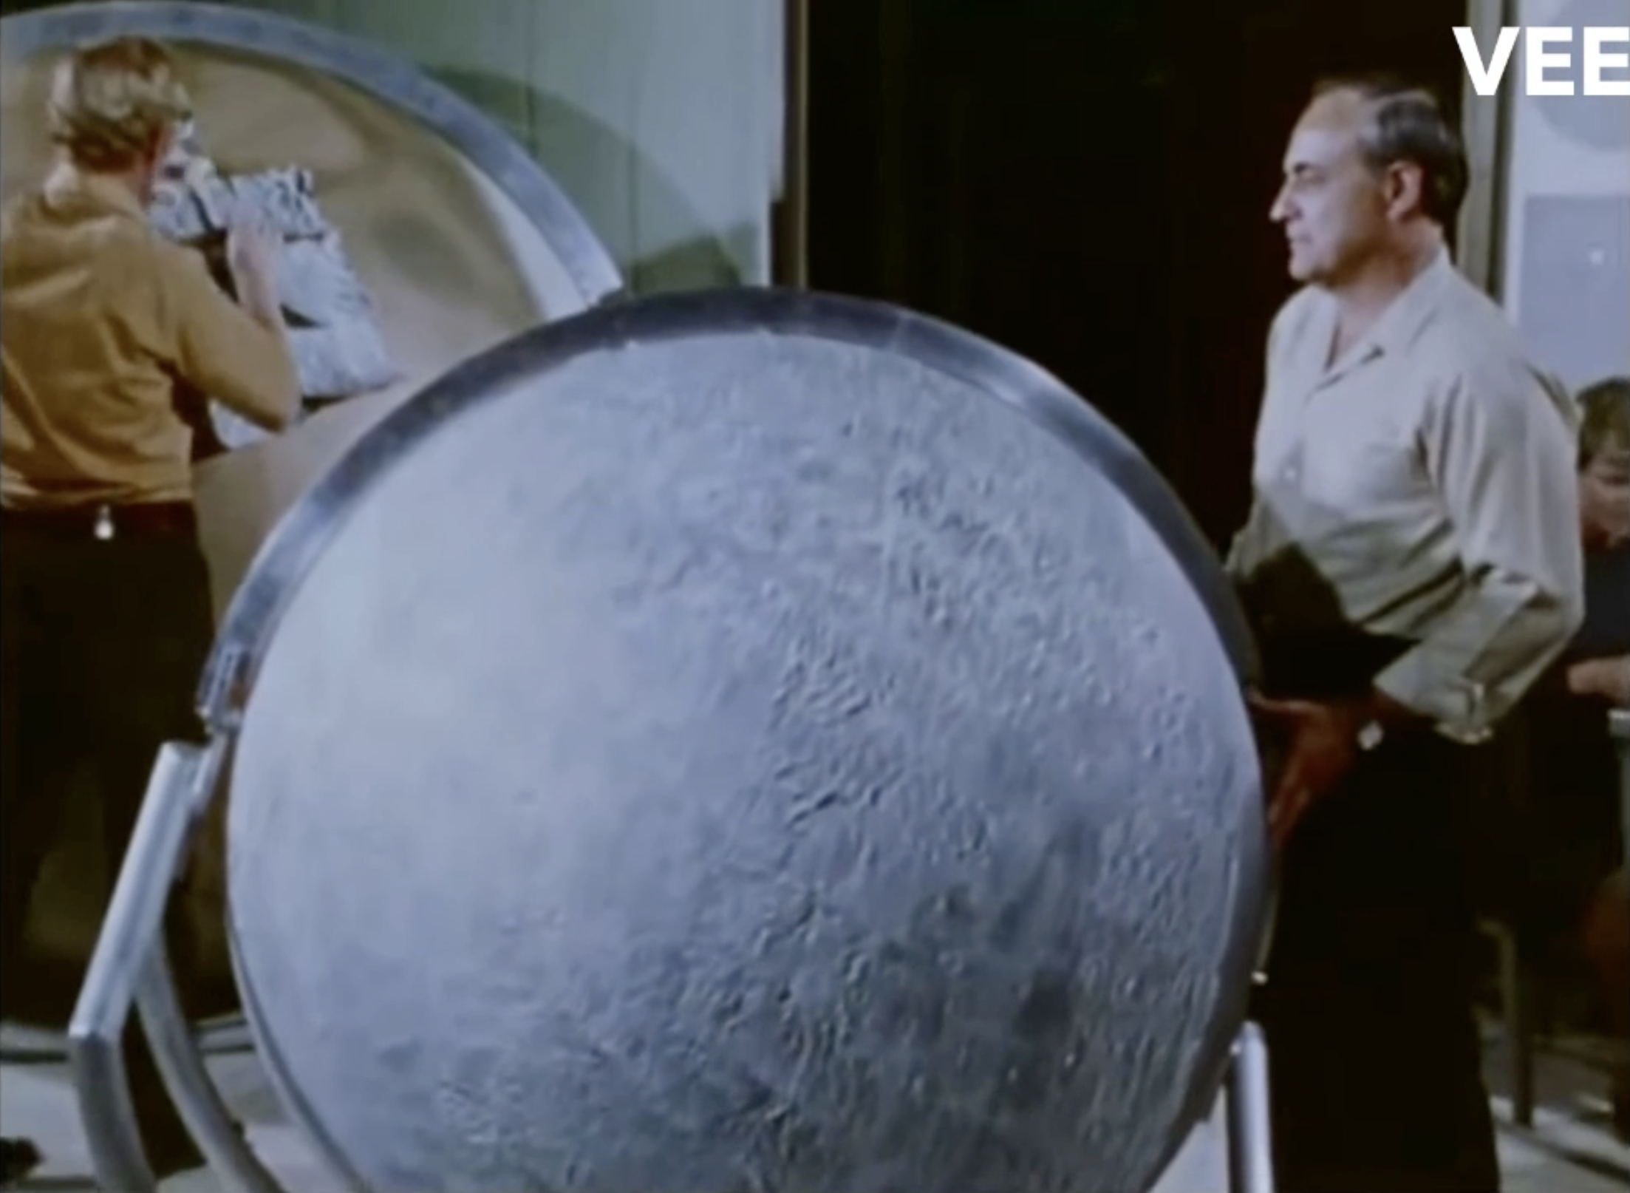
Mariner 9: Globe Construction

Slide 34
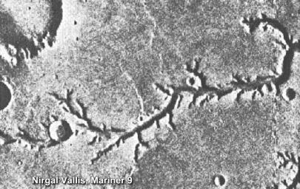
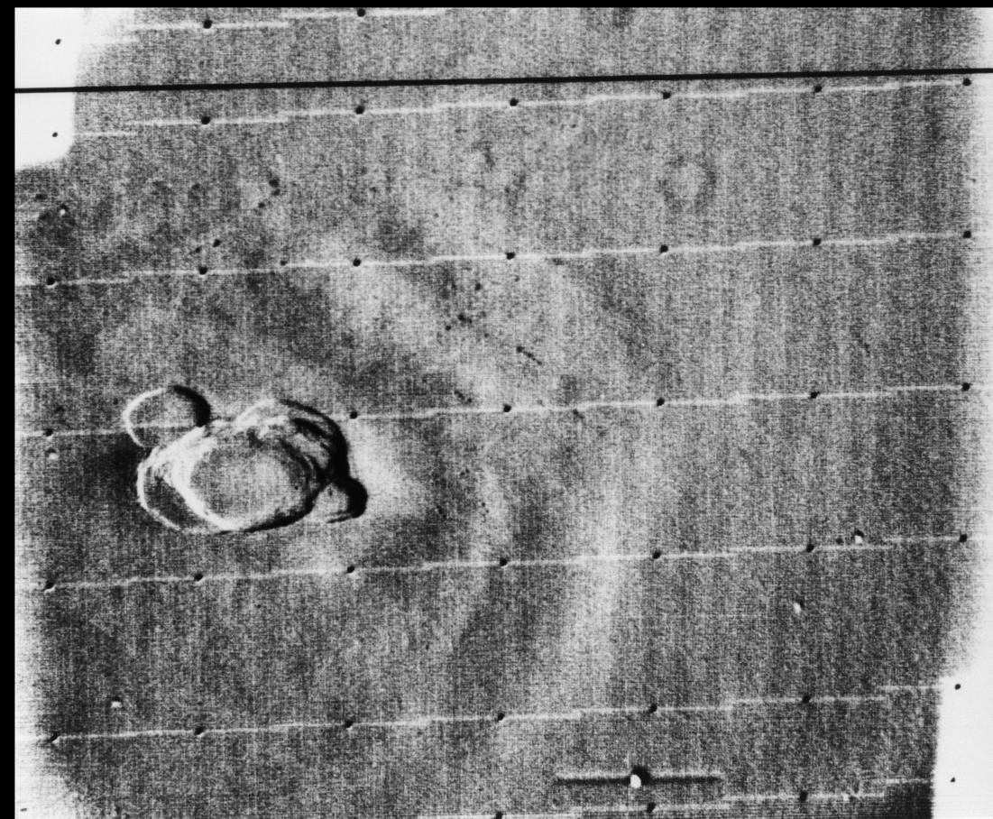
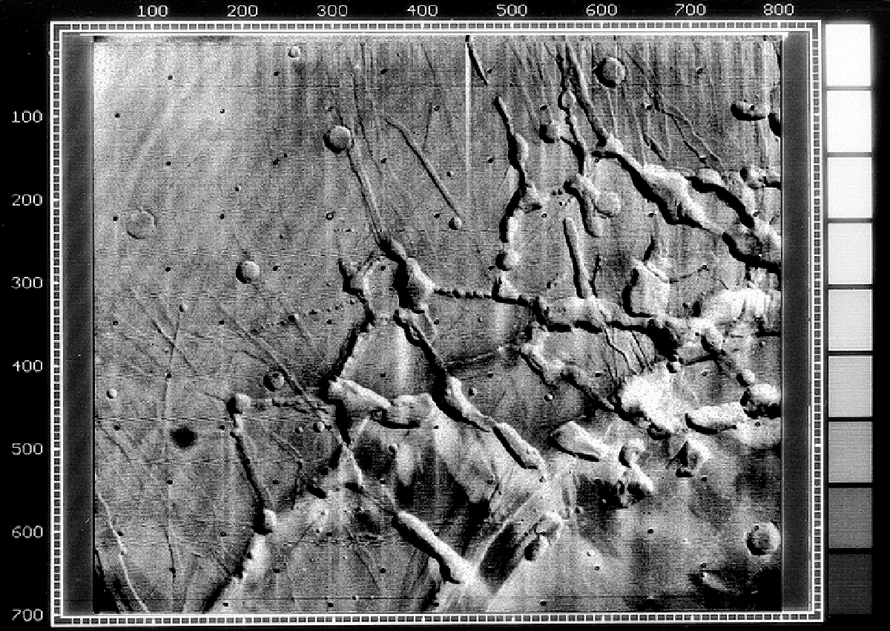
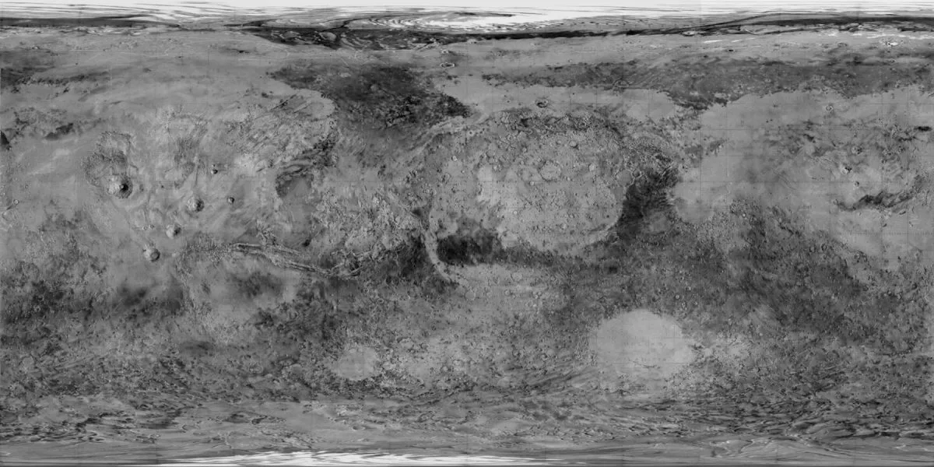
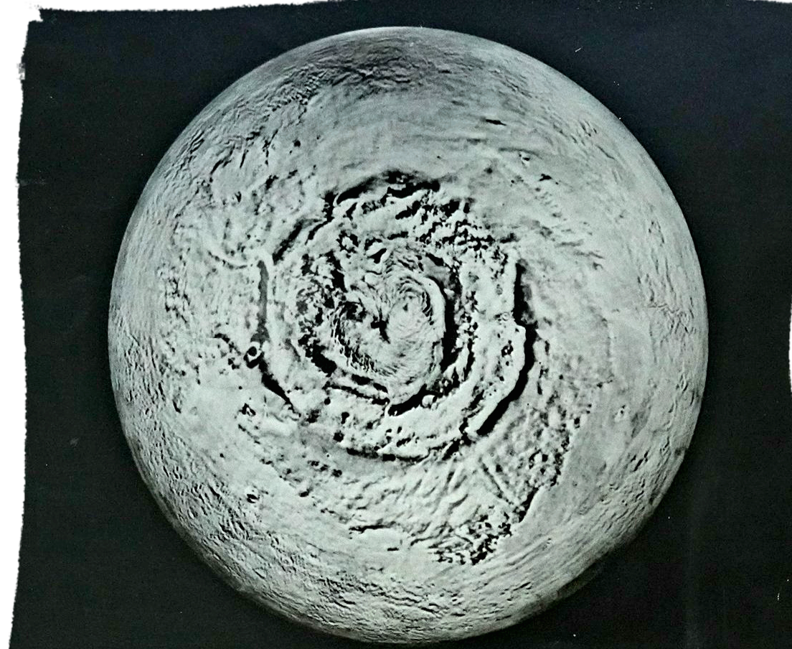
Mariner 9 images

Slide 35
Perspective after the Mariners
2016 NASA Symposium “Viking at 40” at the Langley Research Center
Ellen Stofan has a PhD in Geology and was NASA Chief Scientist from 2013 to 2016
Ellen Stofan (2:27)

Slide 36
Summary and next class
The US eventually was able to send spacecraft to fly by and orbit Mars
We found a planet seemingly hostile to life with very little water and a very thin atmosphere
But there was tantalizing evidence of past water
Next: 1970’s, especially US Viking landers and 1990’s, especially US Pathfinder/Sojourner

Slide 38
An early time line
First German V2 ballistic missile: October 1942
Russian R1 ballistic missile: November 1950
US Redstone ballistic missile: August 1953
USSR Sputnik 1: October 1957
USSR Sputnik 2: flies Laika the dog in November 1957
US Explorer 1: February 1958
USSR Luna 1: flies by the moon in January 1959
USSR Luna 2: crashes on the moon in September 1959
Yuri Gagarin’s flight: April 1961 (Q1?)
Alan Shepard’s flight: May 1961 (Q2?)
USSR Venera 1: flies by Venus in May 1961 (no data at Venus)
US Mariner 2: flies by Venus in August 1962
US Ranger 7: returns moon pictures before crashing in August 1964
US Mariner 4: Mars flyby in July 1965
USSR Luna 9: first successful lunar lander in January 1966
USSR Venera 3: crashes on Venus (communication failure) in March 1966
USSR Venera 4: descends in Venusian atmosphere in June 1967
Apollo 11: July 1969
USSR Venera 7: lands on Venus in December 1970
USSR Mars 3: briefly lands on Mars in May 1971
US Pioneer 1: orbits Venus in May 1978

